Slide 1
Saliency Filters: Contrast Based Filtering for Salient Region Detection
Course : Computer Vision (CSE 578)
Prof. Anoop Namboodiri
Prof. Avinash Sharma
Centre for Visual Information Technology
IIIT Hyderabad, Spring 2019
Students: Udit Singh Parihar | Harshit Kumar Sankhla | Ujjwal Tiwari

Slide 2
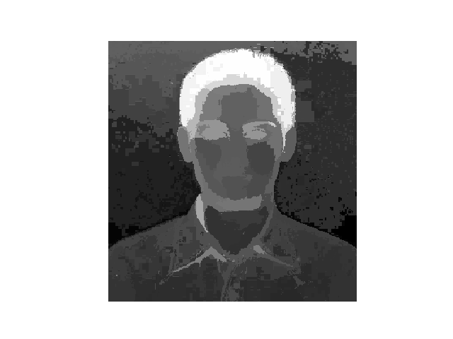
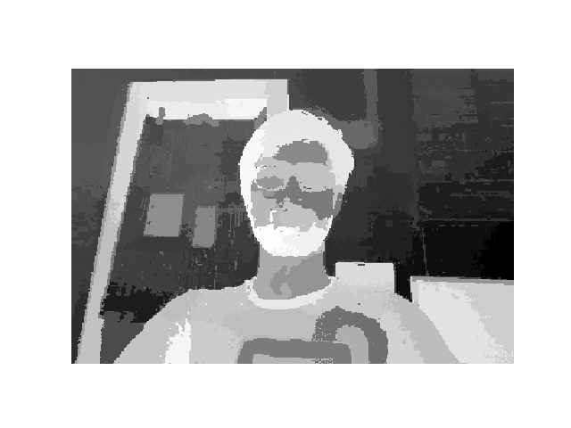
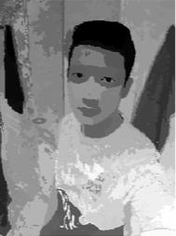
Salient Team Members
Harshit Kumar Sankhla
Ujjwal Tiwari
VISIONARIES !
Udit Singh Parihar

Slide 3
Contents
Introduction
Applications of saliency estimation
Contributions of this paper
Detailed Approach
Results & Failures
Extension
Results and comparison
Deep Learning vs Traditional computer vision methods
References

Slide 4
Terminology 101
Saliency - Quality of being particularly noticeable.
Saliency Map - A saliency map is an image that shows each pixel's unique quality. The goal of a saliency map is to simplify and/or change the representation of an image into something that is more meaningful and easier to analyse. Saliency is a kind of image segmentation.
Image Segmentation - The process of partitioning a digital image into multiple segments (sets of pixels, also known as super-pixels). The goal of segmentation is to simplify and/or change the representation of an image into something that is more meaningful and easier to analyse.

Slide 5
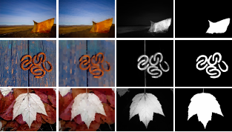
The Problem Statement
The problem of saliency estimation deals with the automatic identification of image elements that catch the attention of a human observer.
The goal of saliency estimation is to find a high level scene description. An understanding of what stands out in an image.
Saliency estimation can also be viewed as a segmentation problem that also produces semantically meaningful Image segments.

Slide 6
Applications
Saliency estimation has found wide applications in computer vision such as:
Mobile robotics [Mobile robot Navigation]
Object Detection [Number Plate detection]
Automatic Thumb-nailing
Cropping/Resizing (Seam Carving-content aware image resizing)
Adaptive Compression

Slide 7
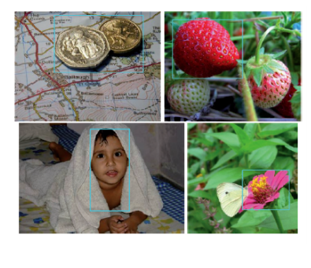
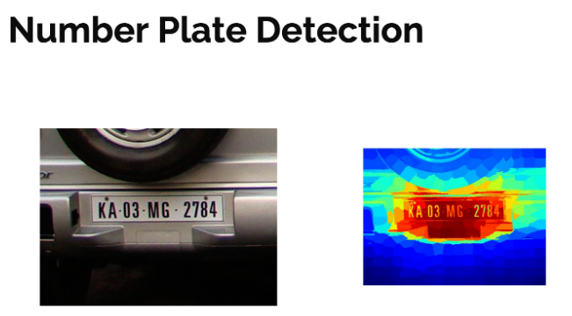

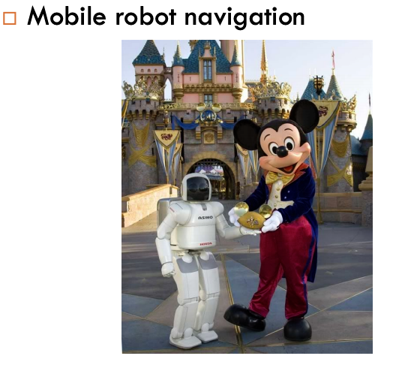
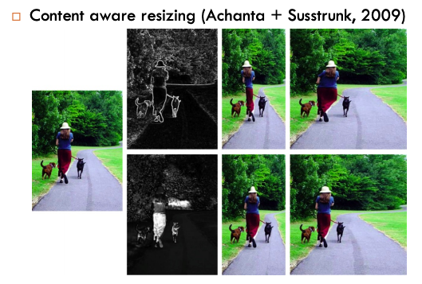

Slide 8
Previous Work and Motivation
Definition of contrast is based on various different types of image features such as colour variation of individual pixels, edges and gradient, spatial frequencies, histograms, multi-scale descriptors etc.
For this work we use two different contrast measures as features for dense estimation of saliency in an Image.

Slide 9
Contributions of the Paper
Contribution 1 : Computation of contrast based features for saliency estimation
Super-segmentation : In this method, Image is decomposed into structurally representative elements that abstract away unnecessary details.
This allows for a very clear and intuitive definition of contrast.
Saliency estimate is based on two well defined contrast measures namely uniqueness and spatial distribution of element which is computed on top of the processed image in the first step.

Slide 10
Contributions of the Paper
Contribution 2 : Modelling the problem to optimise time complexity
Local and global contrast are handled by these measures in a unique way.
Formulation of these measures as single high dimensional Gaussian filtering framework accounts for a highly efficient implementation with linear complexity O(N).

Slide 11
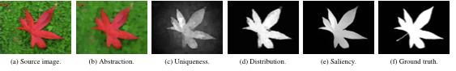
Detailed Approach

Slide 12
Detailed Approach
Step 1 - Abstraction
Decompose the image into basic elements that preserve relevant structure, but abstract undesirable detail.
Each element locally abstracts image by clustering pixels with similar properties.
Strong contours and edges in the image are preserved.
To achieve this decomposition we implement a localised over segmentation over the image using SLIC Super-pixels.
SLIC segments image by using K-means clustering in RGBXY space.
In this paper this is done in CIELab space using geodesic image distance. Geodesic distance guarantees connectivity, while retaining locality compactness and edge aware.

Slide 13
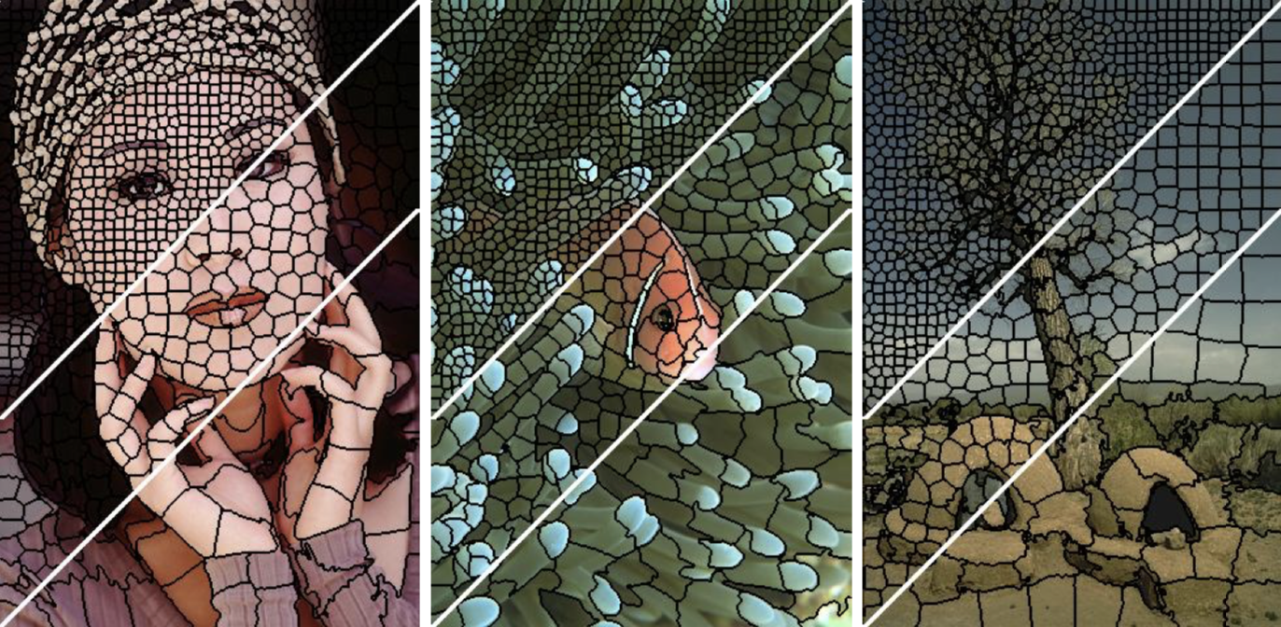
Detailed Approach
SLIC
The algorithm proposed, Simple Linear Iterative Clustering (SLIC) performs a local clustering of pixels in the 5-D space defined by the L,a,b values of the CIELAB colour space and the x,y pixel coordinates. A novel distance measure enforces compactness and regularity in the superpixel shapes, and seamlessly accommodates grayscale as well as colour images. SLIC is simple to implement and easily applied in practice – the only parameter specifies the desired number of superpixels.

Slide 14
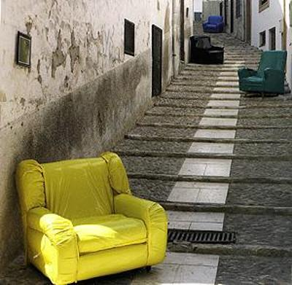
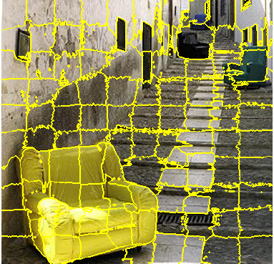
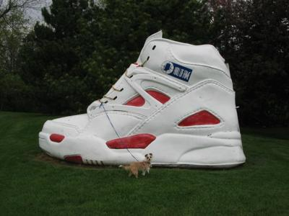
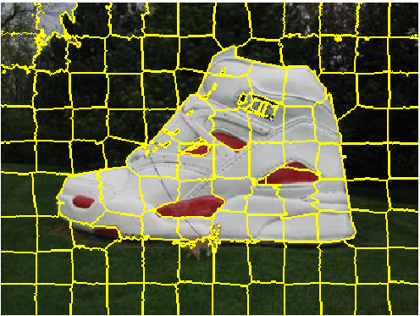
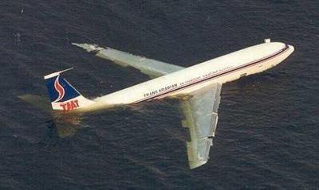
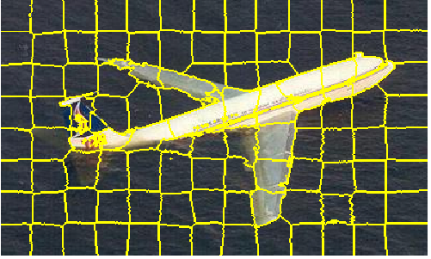

Slide 15
Detailed Approach
Step 2 - Element Uniqueness
The definition of uniqueness is the rarity of segment i, given its position pi and colour in CIELab ci compared to all other segments j.
Global operator does not represent sensitivity to local contrast variation.
Evaluating this globally requires O(N²), N is the number of segments. Methods that down sample the image are prone to blurring the edges.
However, for Gaussian weights, this can be done in O(N). Zi is the normalising factor and sigma controls the range of uniqueness operator.

Slide 16
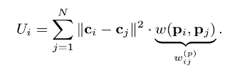
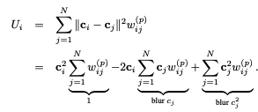
Uniqueness defined by colour similarity and cluster position
Expanding the terms, reducing time complexity

Slide 17
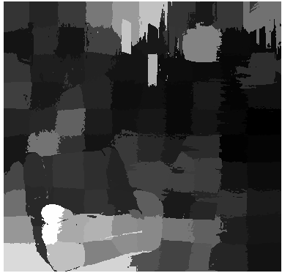
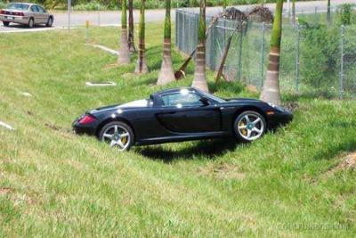
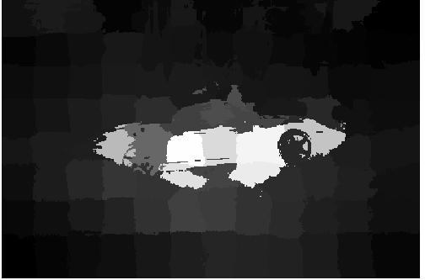
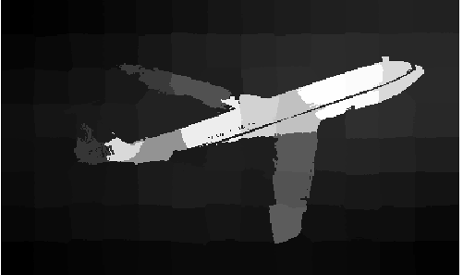

Slide 18
Detailed Approach
Step 3 - Element Distribution
Grouping based on compactness of salient features
Variance term Di based on spatial position and similarity between colours
The weightage term is set to be Gaussian for reducing quadratic complexity to linear.

Slide 19
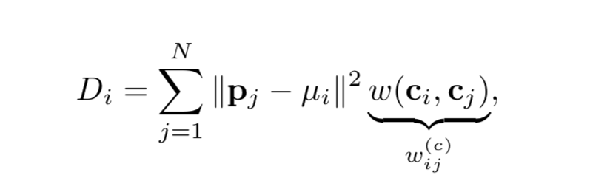
Uniqueness defined by colour similarity and cluster position

Slide 20
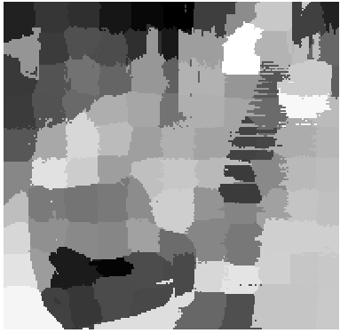
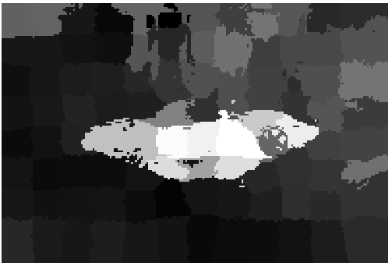
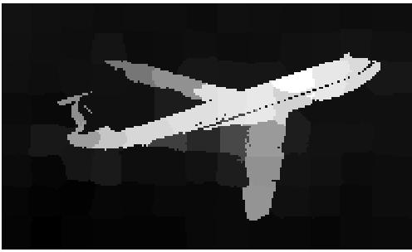

Slide 21
Detailed Approach
Step 4 - Saliency Assignment
We start by normalising both uniqueness Ui and distribution Di to the range [0,…,1]
We compute saliency values Si as a combination of uniqueness and distribution values for the clusters.
We use K = 6 as the scaling factor for the exponential.

Slide 22
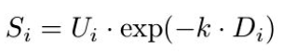
Final Saliency Assignment

Slide 23
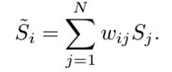
As the final step, we need to assign a final saliency value of each image pixel, which can be interpreted as an upsampling of the per-element saliency Si
We define the saliency Ši of a pixel as a weighted linear combination of the saliency Sj of its surrounding image elements.
By choosing a Gaussian weight as we can ensure that the upsampling process is both local and colour sensitive.
Here alpha and beta are parameters controlling the sensitivity to colour and position.

Slide 24
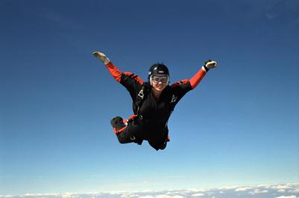
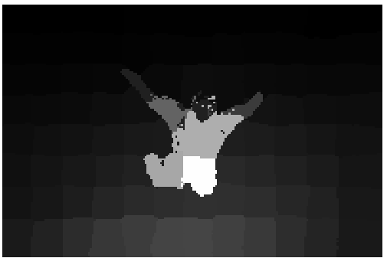
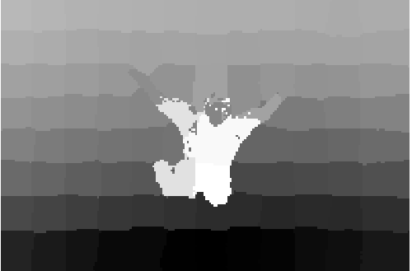
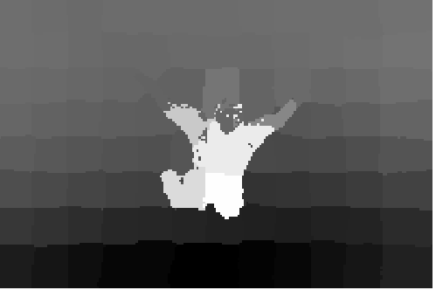

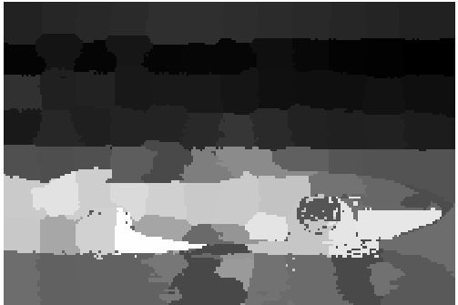
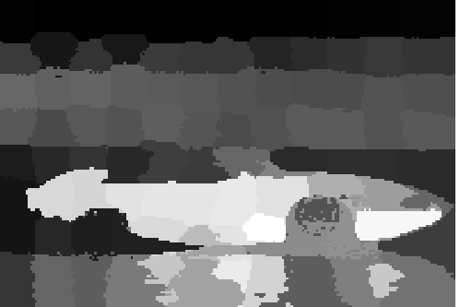
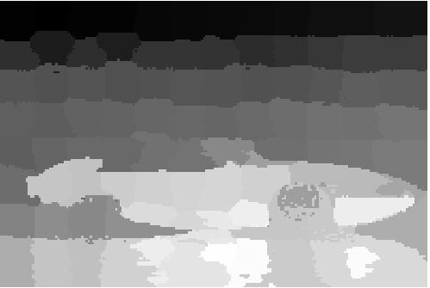
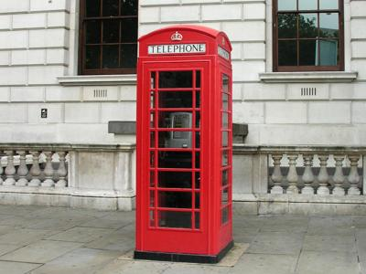
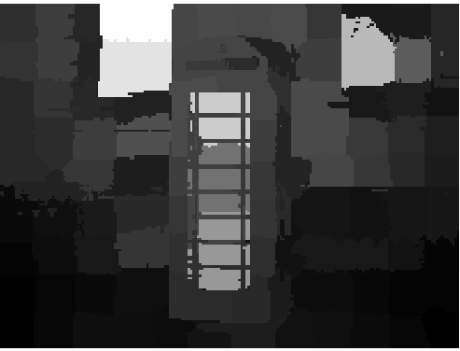
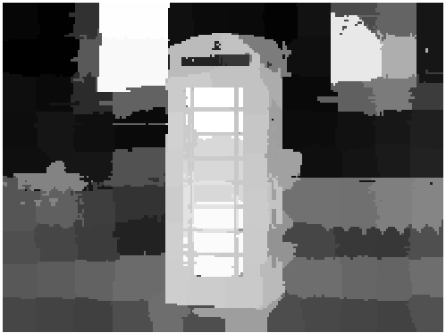
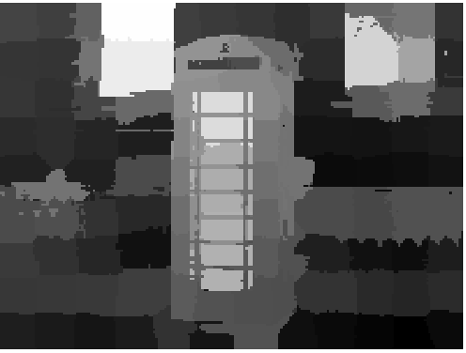
ORIGINAL
UNIQUENESS
DISTRIBUTION
SALIENCY

Slide 25

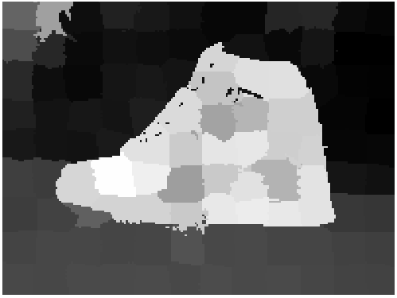
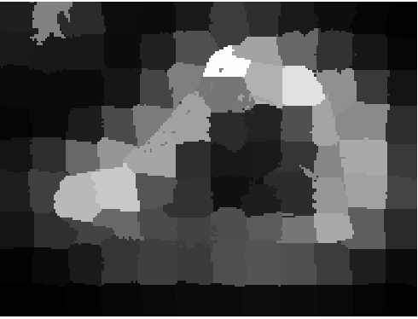
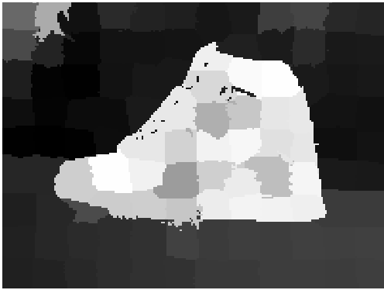
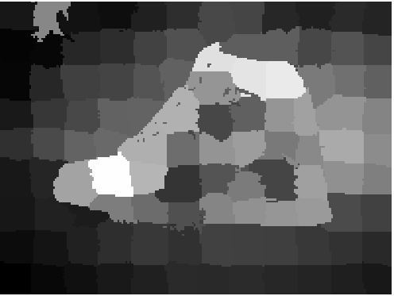
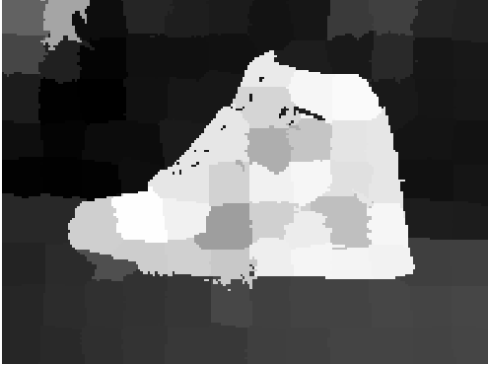
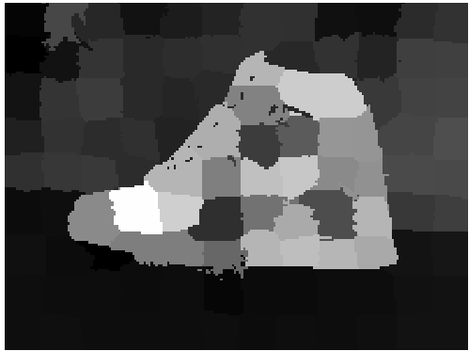
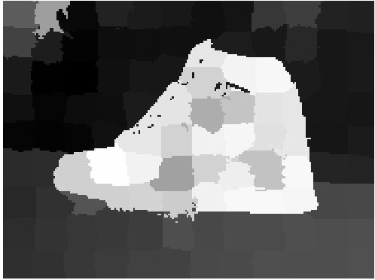
Varying Sigma for Uniqueness
0.01
0.1
UNIQUENESS
SALIENCY
0.25
1

Slide 26
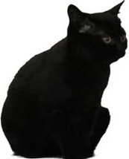
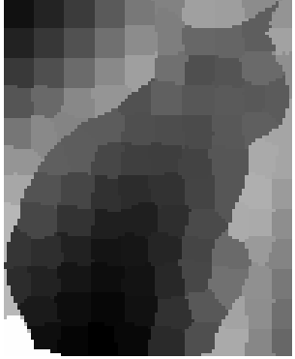
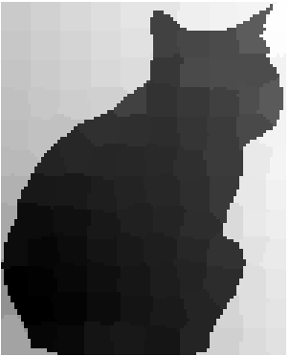
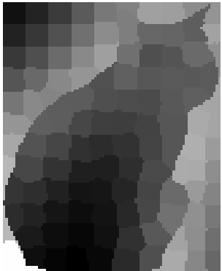


Why Both Uniqueness and Distribution ?
UNIQUENESS
DISTRIBUTION
SALIENCY
Without the distribution term, just the rarity of the colour is insufficient to correctly identify salient objects.

Slide 27




Observed Limitation
ORIGINAL
UNIQUENESS
DISTRIBUTION
SALIENCY
Colour similar to background have low uniqueness, due to low rarity factor. Distribution is able to recover most of the colours lost in uniqueness, due to compactness of region.

Slide 28

Precision and Recall
METHOD 1
Compare binary masks for every threshold in the range [0..255]. The resulting curves show that the algorithm consistently produces results closer to ground truth at every threshold and for any given recall rate

Slide 29


Precision and Recall
METHOD 2
Use the image dependent adaptive threshold, defined as twice the mean saliency of the image. In the above equations, W and H are the width and the height of the saliency map S, respectively. In addition to precision and recall we compute their weighted harmonic mean measure or F- measure

Slide 30

Mean Absolute Error
Estimates the negative saliency assignments
Number of pixels correctly marked as non-salient
Mean of absolute error of saliency map, S and ground truth

Slide 31
https://ieeexplore.ieee.org/document/937655
Dataset Used - database of human segmented natural images and its application to evaluating segmentation algorithms and measuring ecological statistics

Slide 32
EXPERIMENTATION WITH GMMs

Slide 33


WHY GMM ?
K - MEANS LIMITATIONS:
1.Point totally belongs to cluster or not, hard labelling.
2. Fails when clusters are unequal size.
3. Overlapping clusters.
GAUSSIAN MIXTURE MODELS:
1. Works on overlapping, unequal size data.
2. Feature vectors experimented on RGB, RGBXY and LABXY space.

Slide 34








SLIC vs GMM - 1 Distinction from Background
SLIC
GMM
UNIQUENESS
DISTRIBUTION
SALIENCY
DISTRIBUTION
FINAL SALIENCY
GMM SUPERPIXELS
UNIQUENESS

Slide 35







SLIC vs GMM - 2 Internal Structure
SLIC
GMM
UNIQUENESS
DISTRIBUTION
SALIENCY
DISTRIBUTION
FINAL SALIENCY
GMM SUPERPIXELS
UNIQUENESS

Slide 36






SLIC vs GMM - 3 Distant Objects
SLIC
GMM
UNIQUENESS
DISTRIBUTION
SALIENCY
DISTRIBUTION
FINAL SALIENCY
GMM SUPERPIXELS
UNIQUENESS

Slide 37






SLIC vs GMM - 4 Sharpness Along Edges
SLIC
GMM
UNIQUENESS
DISTRIBUTION
SALIENCY
DISTRIBUTION
FINAL SALIENCY
GMM SUPERPIXELS
UNIQUENESS

Slide 38

Qualitative Comparison of Traditional Methods with Deep Learning Models
Formulation driven vs Data driven approach: High computation cost. (Both memory and time complexity.)
Interpretability of both approach and results in a traditional methods.
Deep learning method need a lot of data to train! Data is abundant but task specific data and standard data is expensive and hard to find.
Debugging: Due to this interpretability traditional methods are easier to debug.
However, traditional methods like these are extremely biased towards contrast prior, background prior. As formulations are rigid they scaled to diverse set of images that do not conform to the mathematical formulation and its assumptions.

Slide 39
References
1. Saliency Filters : contrast based saliency estimation. [ LINK]
2. Efficient Salient Region Detection with Soft Image Abstraction. [LINK]
3. A model of saliency-based visual attention for rapid scene analysis. [LINK]
4. SLIC Superpixels. Technical report. [LINK]
5. Learning to detect a salient object. [ LINK]
6.Improved saliency detection based on superpixel clustering and saliency propagation. [ LINK]
7. Global contrast based salient region detection. [LINK]

Slide 40


